Slide 1

Using Hue
Team - 04

Slide 2



Team Members
Abhishek Telugu
Nandini Yadav Janga
Chaitra Vemula

Slide 3
Contents
What is Hue?
Why Hue?
Features
Why Hue UI for Hadoop?
Infrastructure
Hue Usage
Hue Components
DEMO
Conclusion
Abhishek Telugu

Slide 4
What is Hue?
Hue is nothing but Hadoop User Experience.
It is a web based interactive query editor that enables you to interact with data warehouses.
It is an open source Hadoop GUI which is developed by cloudera.
Abhishek Telugu

Slide 5
Why to use Hue
It is widely used.
It integrates with Hadoop tools like Hive, Oozie, HDFS.
It is an API for app creation.
It has many number of features.
Abhishek Telugu

Slide 6
Hue Features
HDFS file browser.
Job browser / Designer.
Oozie app for work flows.
Hive / Pig / Impala query editor.
Abhishek Telugu

Slide 7
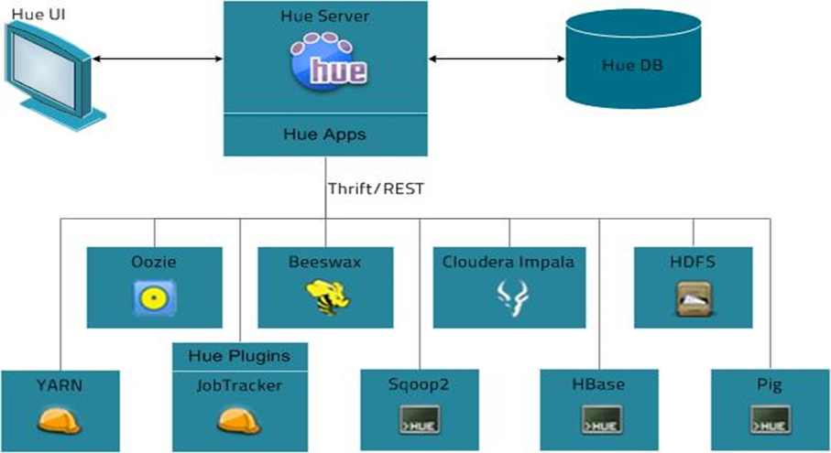
Abhishek Telugu

Slide 8
Why Hue UI for Hadoop
User who are not engineers.
Makes Hadoop easier to use
Presents the power of big data to basic users
User who use or know Command Line Interface
Chaitra Vemula

Slide 9
Infrastructure
Front End
Mako Templates
JQuery
KnockoutJS
Back End
Python + Django driven
Thrift + Web Clients for Hadoop Components
Spawning/CherryPy
SDK
Make your own App!
“build/env/bin/hue Create_desktop_app <name>”
Chaitra Vemula

Slide 10
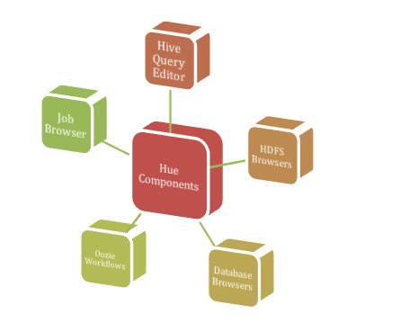
Hue Components
Chaitra Vemula

Slide 11
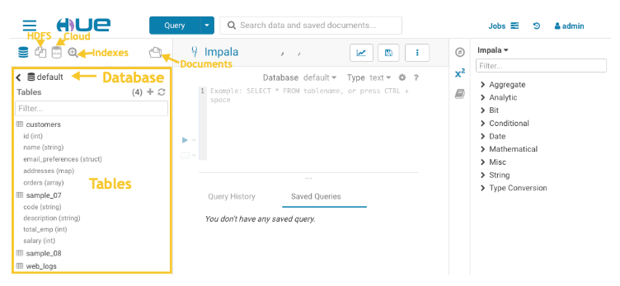
Hue usage
Explore, browse, and import your data through guided navigation in the left panel of the page:
Chaitra Vemula

Slide 12
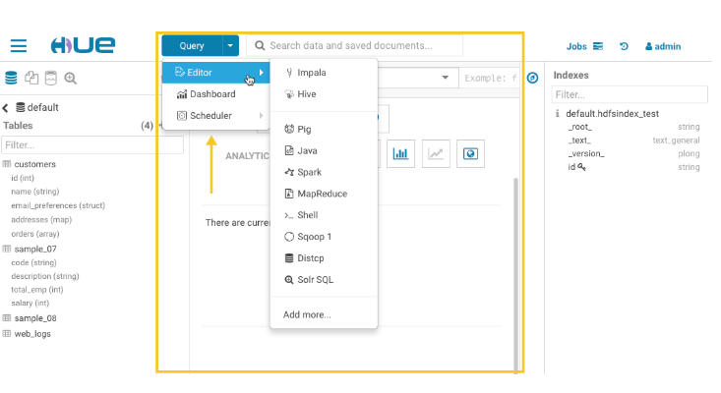
Central Panel
Chaitra Vemula

Slide 13
DEMO
Nandini Yadav Janga

Slide 14
Conclusion
We have given the introduction to Hue tools. It provides an easy to use user interface that can be used to process all steps of Hadoop ecosystem.
You can access all Hadoop services through Hue interface.
You can use Hue platform easily.
Nandini Yadav Janga

Slide 15
Any Queries?
Thanks You

